Slide 1
DSA 503
CHI-SQUARE TEST

Slide 2

THE CHI-SQUARE DISTRIBUTION
Definition
The chi-square distribution has only one parameter called the degrees of freedom. The shape of a chi-squared distribution curve is skewed to the right for small df and becomes symmetric for large df. The entire chi-square distribution curve lies to the right of the vertical axis. The chi-square distribution assumes nonnegative values only, and these are denoted by the symbol χ² (read as “chi-square”).

Slide 3

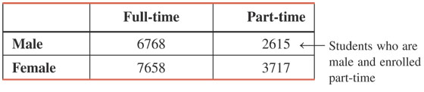
CONTINGENCY TABLES

Slide 4

A TEST OF INDEPENDENCE OR HOMOGENEITY
A Test of Independence
Prem Mann, Introductory Statistics, 7/E Copyright © 2010 John Wiley & Sons. All right reserved

Slide 5
A Test of Independence
Definition
A test of independence involves a test of the null hypothesis that two attributes of a population are not related. The degrees of freedom for a test of independence are
df = (R – 1)(C – 1)
Where R and C are the number of rows and the number of columns, respectively, in the given contingency table.

Slide 6
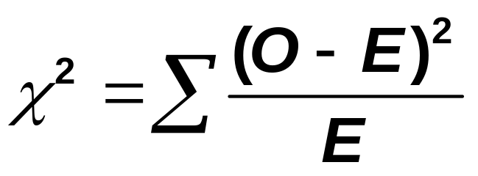
A Test of Independence
Test Statistic for a Test of Independence
The value of the test statistic χ² for a test of independence is calculated as
where O and E are the observed and expected frequencies, respectively, for a cell.

Slide 7
Example 11-5
Violence and lack of discipline have become major problems in schools in the United States.
A random sample of 300 adults was selected, and these adults were asked if they favor giving more freedom to school teachers to punish students for violence and lack of discipline.
The two-way classification of the responses of these adults is represented in the following table.

Slide 8
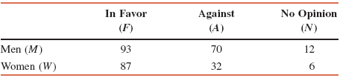
Example 11-5
Calculate the expected frequencies for this table, assuming that the two attributes, gender and opinions on the issue, are independent.

Slide 9
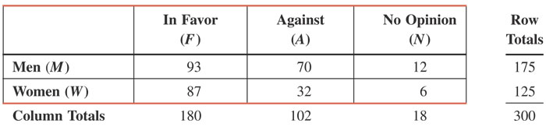
Example 11-5: Solution
Table 11.6 Observed Frequencies

Slide 10
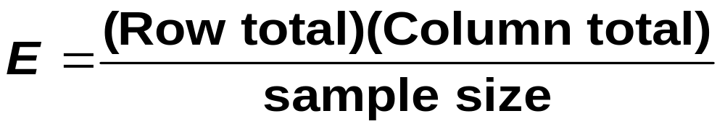
Expected Frequencies for a Test of Independence
The expected frequency E for a cell is calculated as

Slide 11
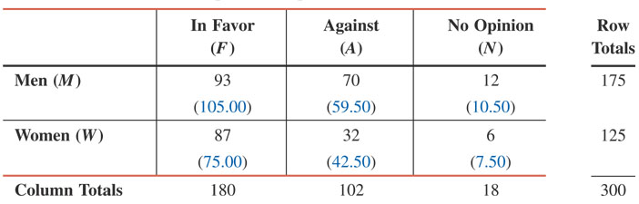
Example 11-5: Solution
Table 11.7 Observed and Expected Frequencies

Slide 12
Example 11-6
Reconsider the two-way classification table given in Example 11-5. In that example, a random sample of 300 adults was selected, and they were asked if they favor giving more freedom to school teachers to punish students for violence and lack of discipline. Based on the results of the survey, a two-way classification table was prepared and presented in Example 11-5.
Does the sample provide sufficient information to conclude that the two attributes, gender and opinions of adults, are dependent? Use a 1% significance level.

Slide 13
Example 11-6: Solution
Step 1:
H₀: Gender and opinions of adults are independent
H₁: Gender and opinions of adults are dependent

Slide 14
Example 11-6: Solution
Step 2: We use the chi-square distribution.
Step 3:Critical value + Regions
α = .01
df = (R – 1)(C – 1) = (2 – 1)(3 – 1) = 2
The critical value of χ² = 9.210

Slide 15
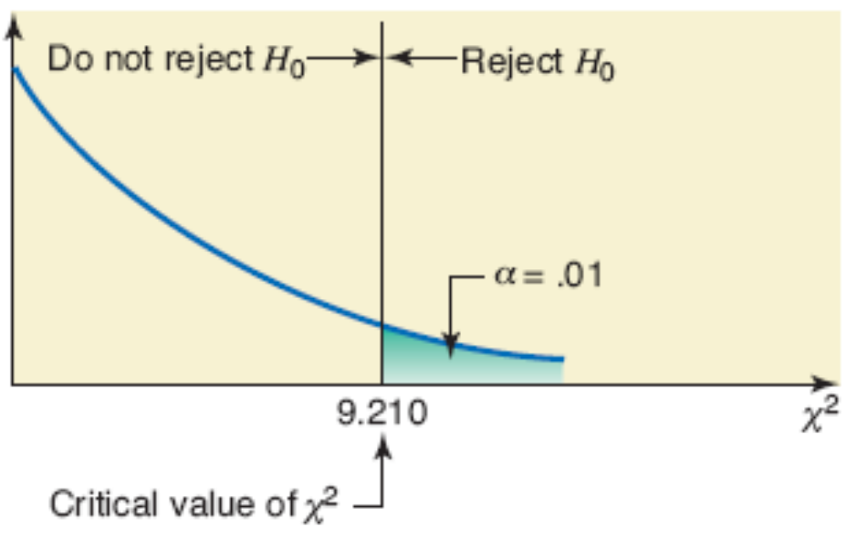
Figure 11.6

Slide 16
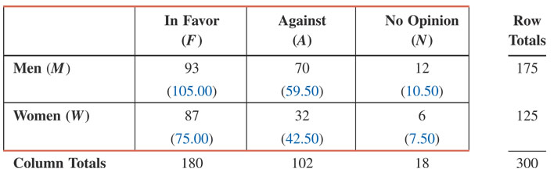
Table 11.8 Observed and Expected Frequencies

Slide 17
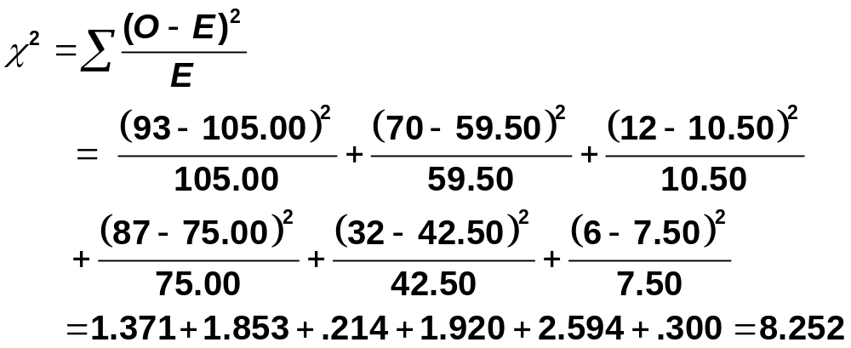
Example 11-6: Solution
Step 4: Test Statistic

Slide 18
Example 11-6: Solution
Step 5: Decision
The value of the test statistic χ² = 8.252
  It is less than the critical value of χ² = 9.210
  It falls in the non-rejection region
Hence, we fail to reject the null hypothesis
Step 6: Conclusion
We conclude that gender and opinions of adults are independent.

Slide 19
R Code: Chi-square test
y<-c(93,70,12,87,32,6)
data<- matrix(y, nrow=2, byrow=T)
> data
[,1] [,2] [,3]
[1,] 93 70 12
[2,] 87 32 6
> chisq.test(data)
Output:
X-squared = 8.2528, df = 2, p-value = 0.01614

Slide 20
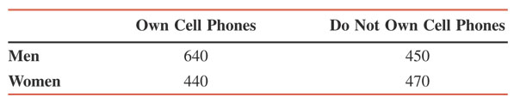
Example 11-7
A researcher wanted to study the relationship between gender and owning cell phones. She took a sample of 2000 adults and obtained the information given in the following table.
At the 5% level of significance, can you conclude that gender and owning cell phones are related for all adults?

Slide 21
Example 11-7: Solution
Step 1:Hypothesis
H₀: Gender and owning a cell phone are not related (i.e., independent)
H₁: Gender and owning a cell phone are related (i.e., dependent)

Slide 22
Example 11-7: Solution
Step 2: Distribution
We use the chi-square distribution
Step 3: Critical Value
α = .05
df = (R – 1)(C – 1) = (2 – 1)(2 – 1) = 1
The critical value of χ² = 3.841

Slide 23
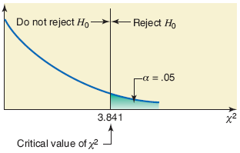
Figure 11.7

Slide 24
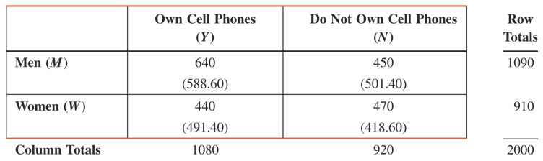
Table 11.9 Observed and Expected Frequencies

Slide 25
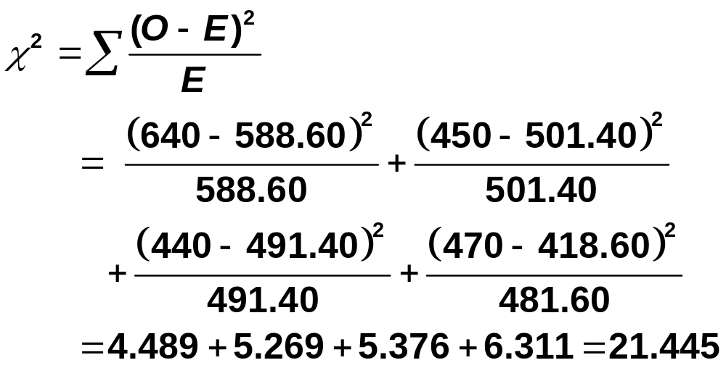
Example 11-7: Solution
Step 4:Test Statistic

Slide 26
Example 11-7: Solution
Step 5: Decision
The value of the test statistic χ² = 21.445
  It is larger than the critical value of χ² = 3.841
  It falls in the rejection region
Hence, we reject the null hypothesis
Step 6: Conclusion
Home work

